Slide 1

Combining ADF-EDX scattering cross-sections for elemental quantification of nanostructures
Collaborators:
Ivan Lobato (EMAT)
Annick De Backer (EMAT)
Thomas Friedrich (EMAT)
Michael William Goode (Oxford)
Zezhong Zhang
Prof. dr. Sandra Van Aert
Prof. dr. Peter Nellist
EMC 2020

Slide 2
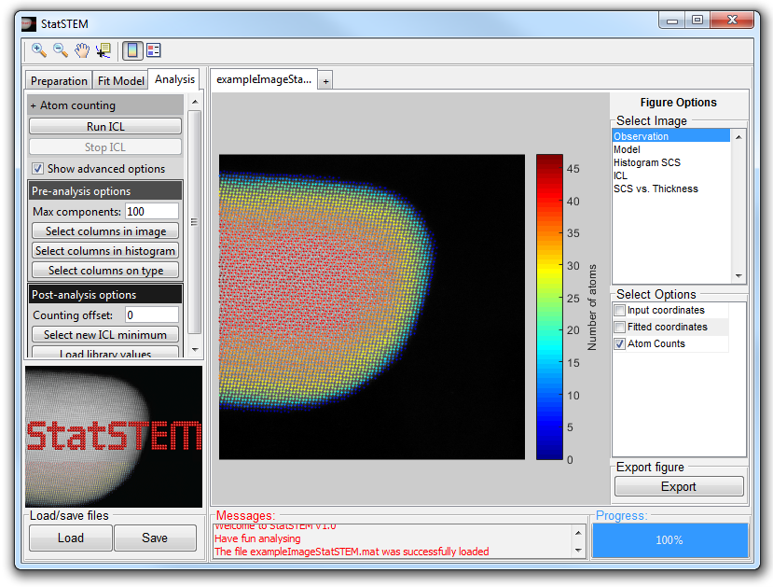
Atom counting based on scattering cross-sections
Well-established for single element system using HAADF-STEM
Ambiguity of thickness and composition in multi-element system. Example: Pt-Au nanoparticle
Combine with spectroscopy for multivariant statistical parameter estimation
Van Aert et al. Nature (2011)
De Backer & van den Bos et al. Ultramicroscopy (2016).

Slide 3
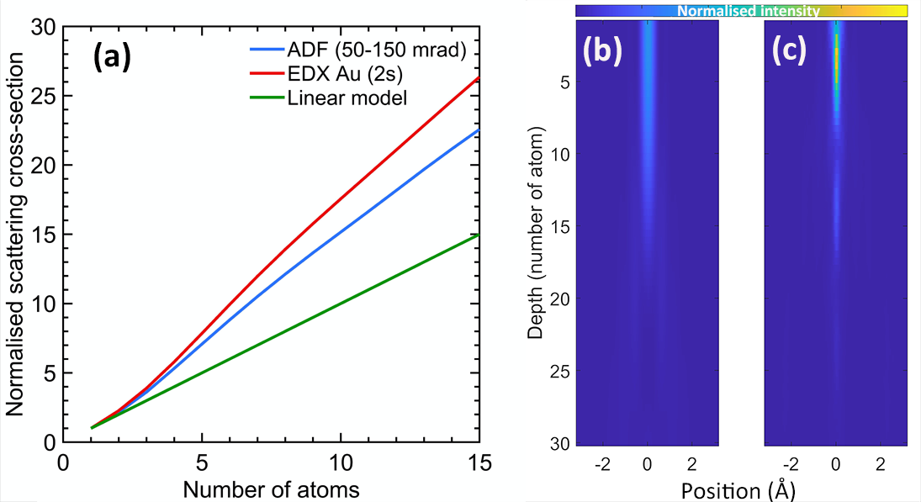
Why channelling matters?
Au [001]
Au crystal
[001]
Vacuum

Slide 4

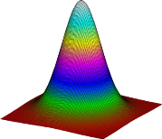
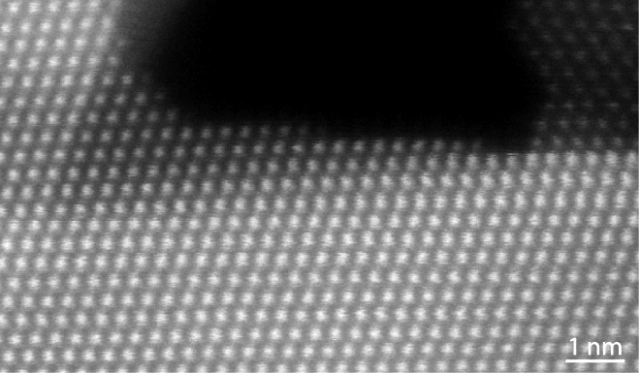
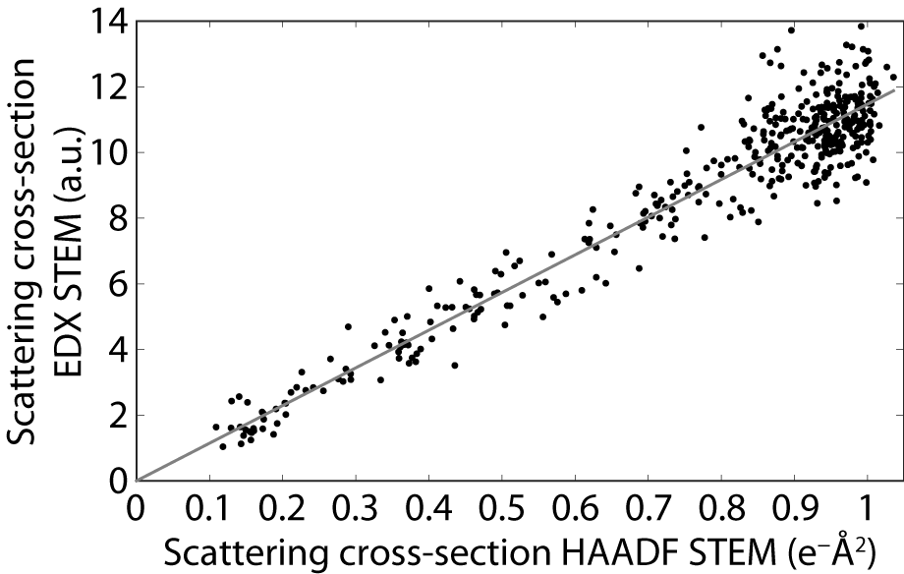

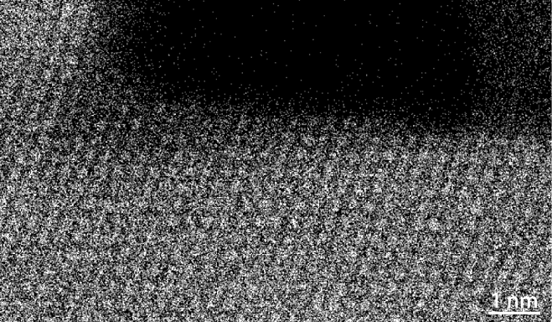


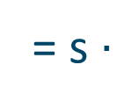
Rapid generate EDX and ADF library, but too many combinations
Karel & Annick work:
developed atomic lensing model
Found experimental linear correlation between ADF-EDS cross-sections

1 element:
58
Ce
Cerium
140.12
γ
e–
γ
?
= s $∙$

* Images acquired by E. Bladt
van den Bos & De Backer et al. PRL 116.24 (2016): 246101.
Van den Bos & De Backer et al Ultramicroscopy 203 (2019): 155-162.
Van den Bos, PhD thesis (2017)
Courtesy: slice from Karel Van den Bos, ATOM 13

Slide 5
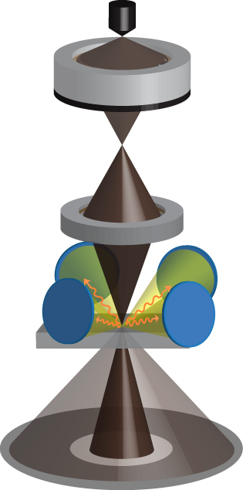
Detector design
Partial Cross-section measurement
Detector range and efficiency are difficult to measure
Aakash work:
measured partial cross-sections experimentally
Varambhia et al Micron (2018)

Slide 6
Outline
EDX calculation using effective potential
ADF-EDS cross-section correlation
Atomic lensing model for spectroscopy

Slide 7
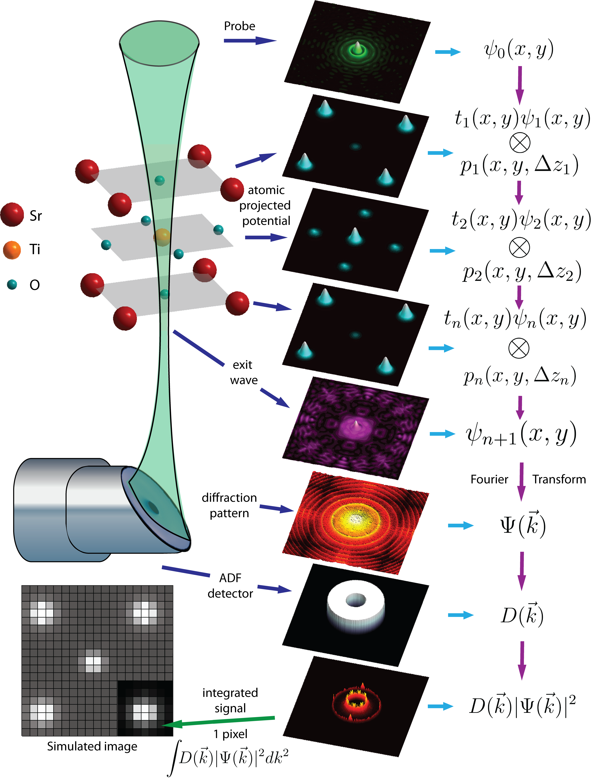

Electron scattering via Multislice
Fig adapted from [Martinez et al. Ultramicroscopy 2015]

Slide 8
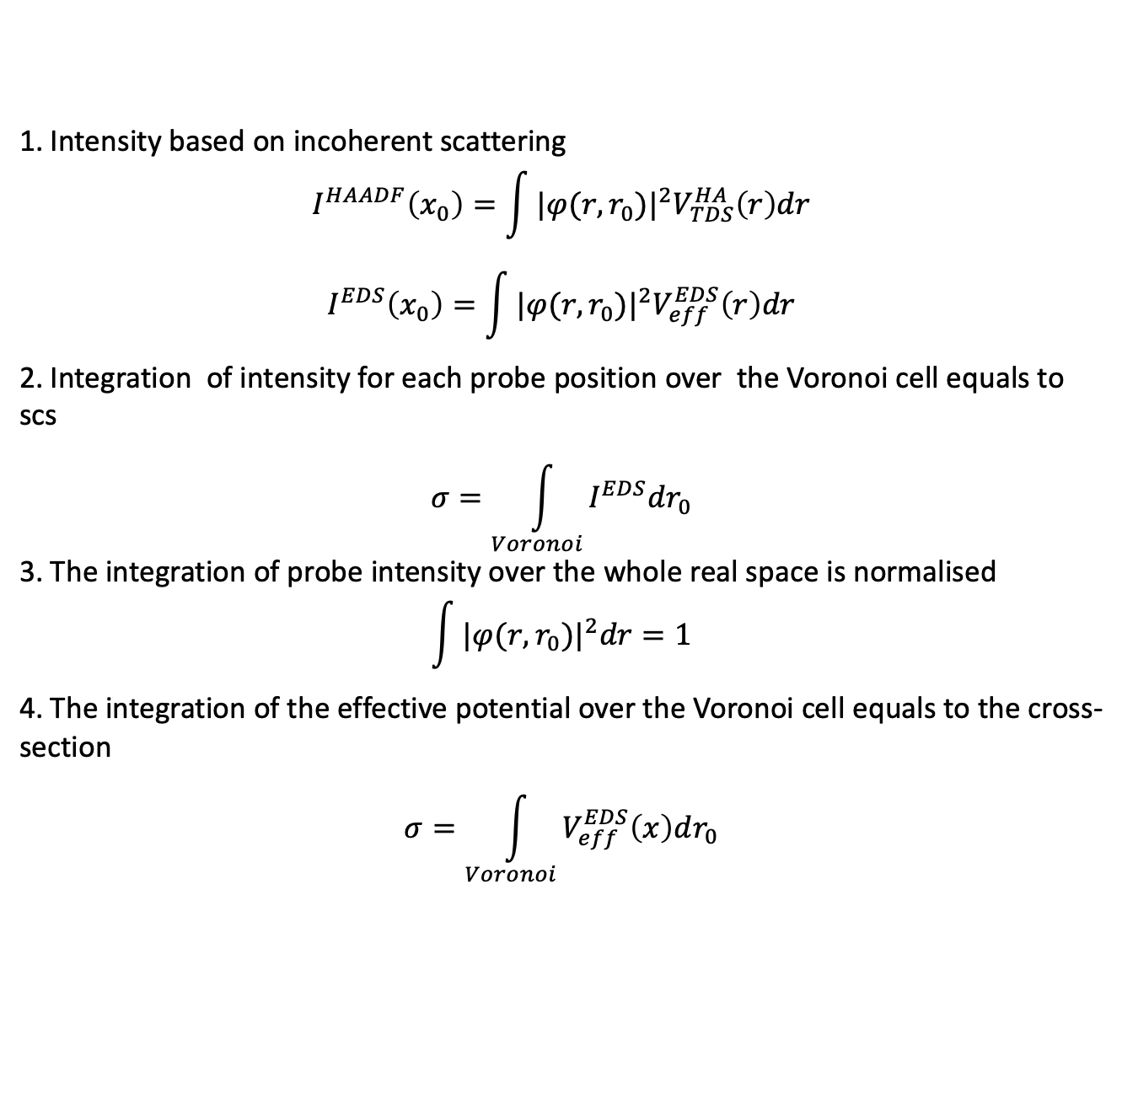
Incoherent approximation
1. Intensity based on incoherent scattering
$$I^{HAADF}\left(x_{0}\right)=\int{{|φ(r,r_{0})|}^{2}V_{TDS}^{HA}\left(r\right)dr}$$
$$I^{EDS}\left(x_{0}\right)=\int{{|φ(r,r_{0})|}^{2}V_{eff}^{EDS}\left(r\right)dr}$$
2. Integration of intensity for each probe position over the Voronoi cell equals to scs
$$σ=\int_{Voronoi}{I^{EDS}dr_{0}}$$
3. The integration of probe intensity over the whole real space is normalised
$$\int{{|φ(r,r_{0})|}^{2}dr=1}$$
4. The integration of the effective potential over the Voronoi cell equals to the cross-section
$$σ=\int_{Voronoi}{V_{eff}^{EDS}\left(x\right)dr_{0}}$$

Slide 9

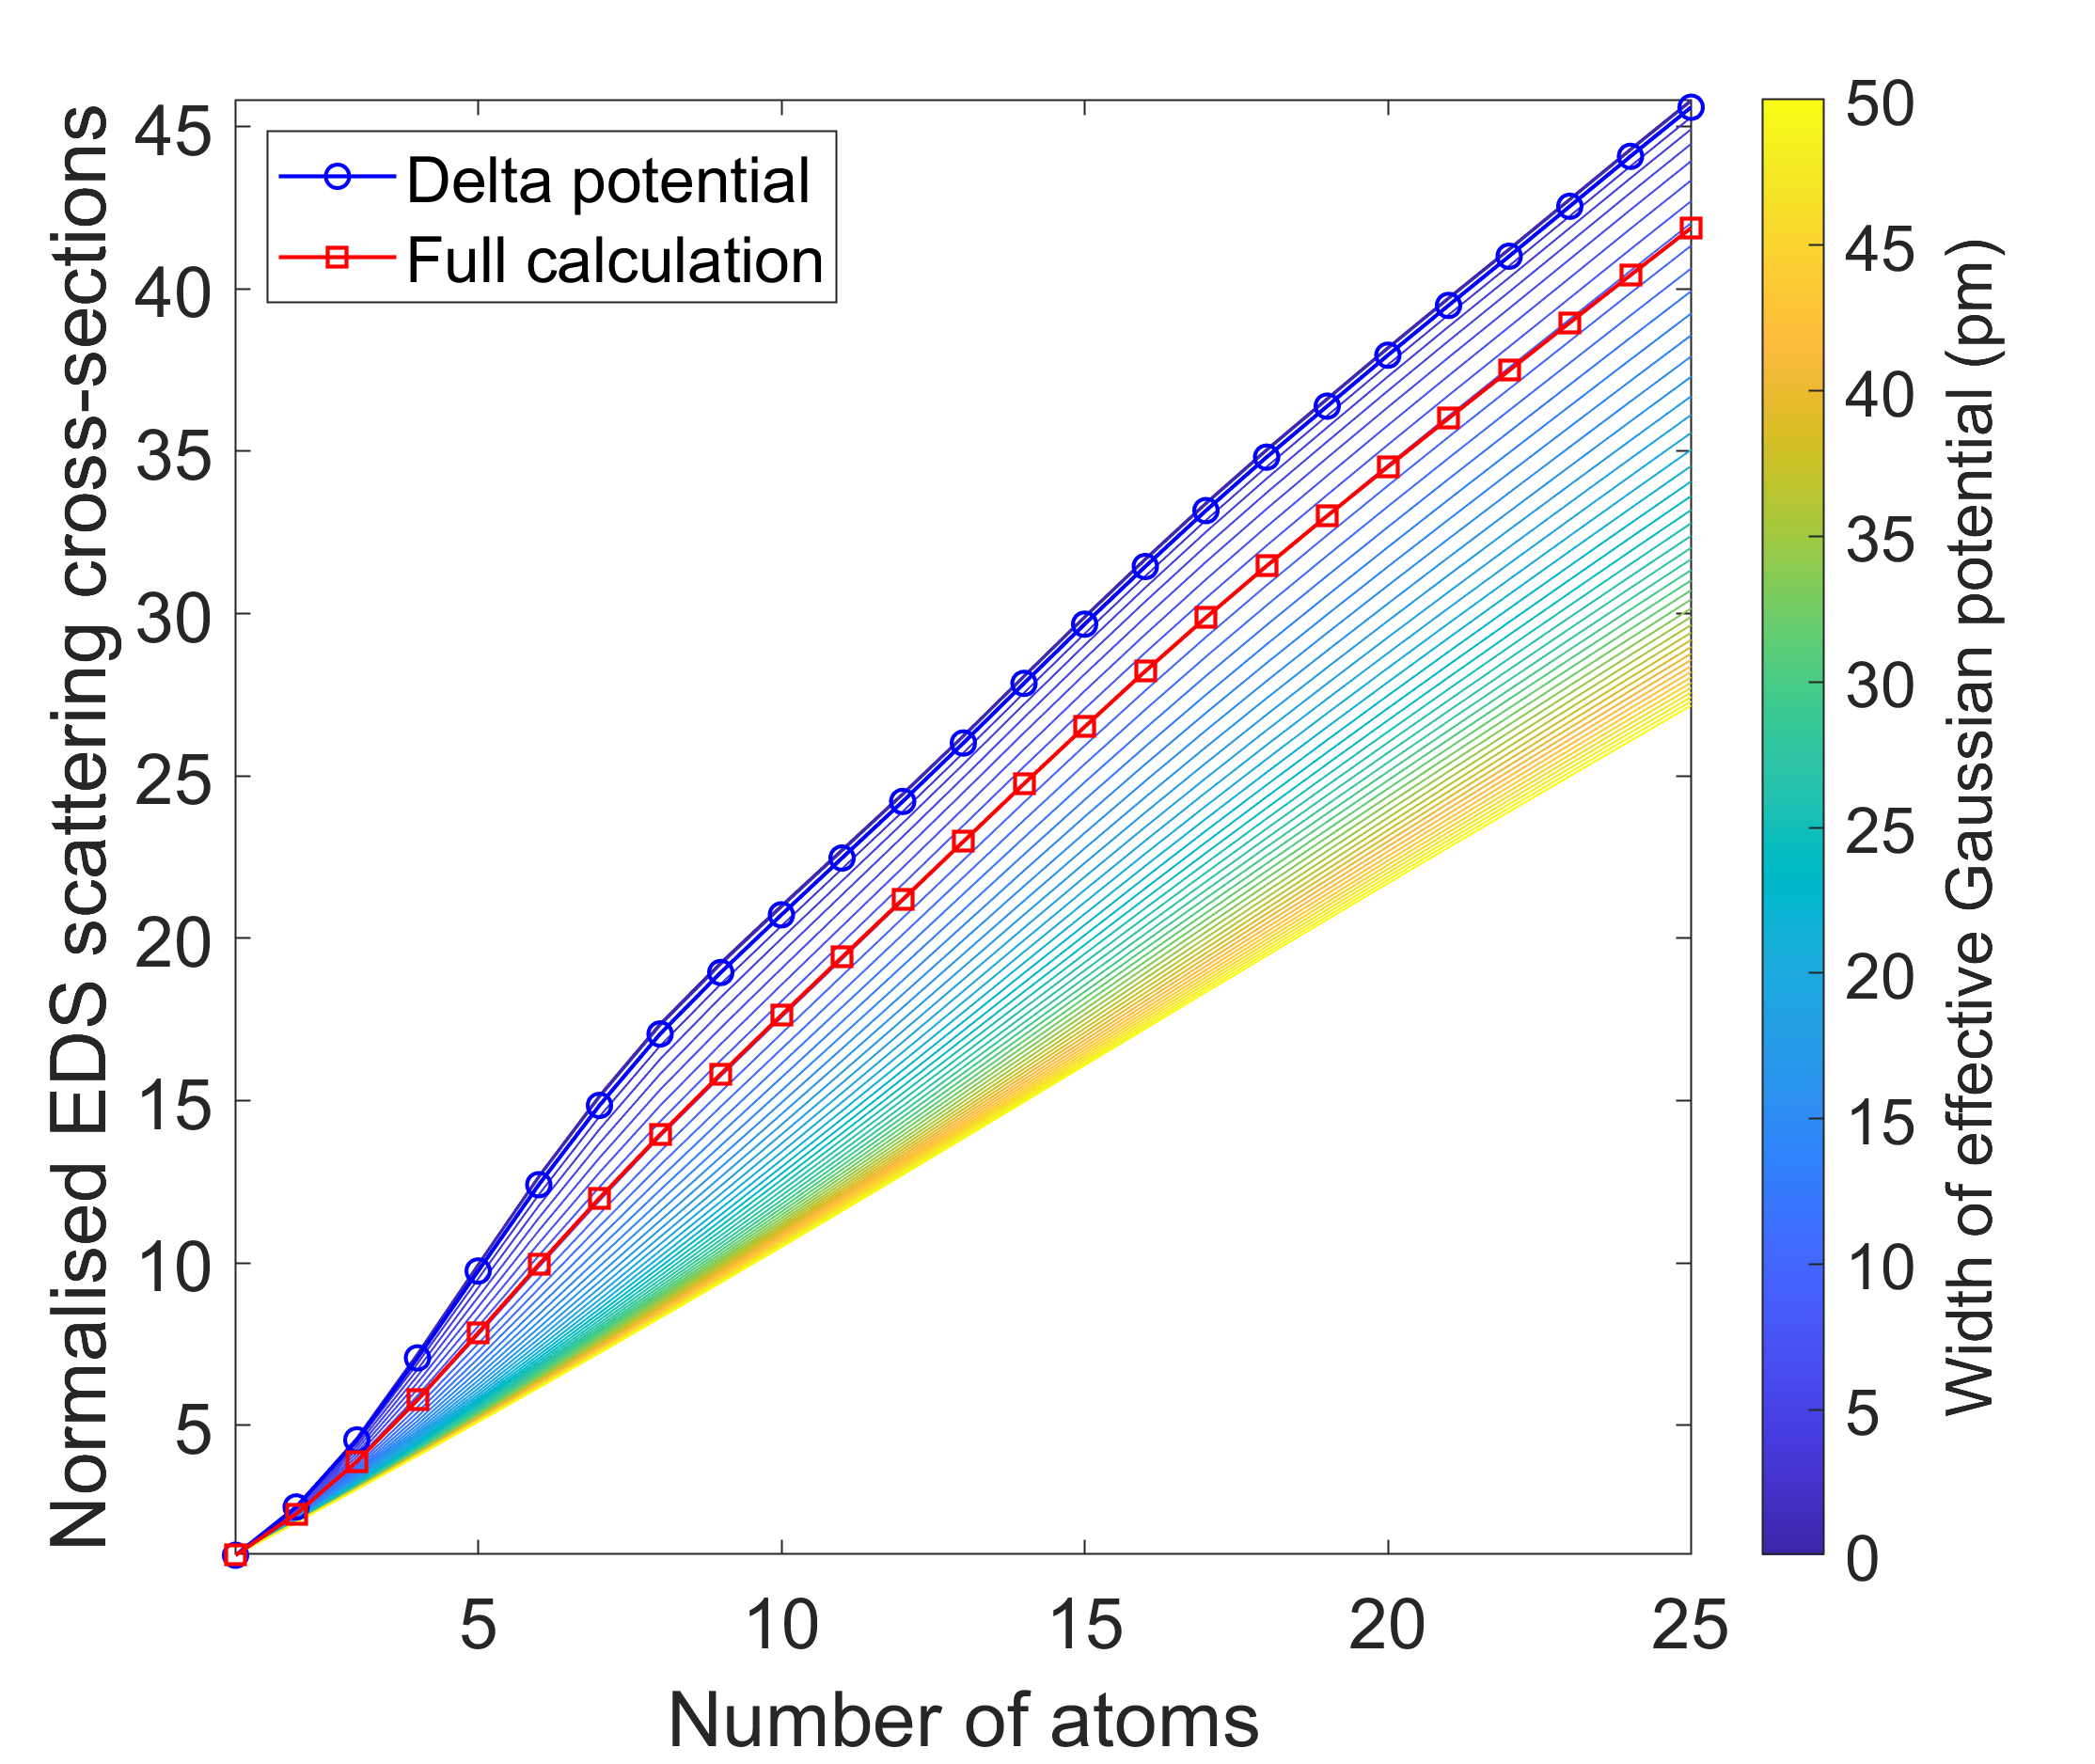
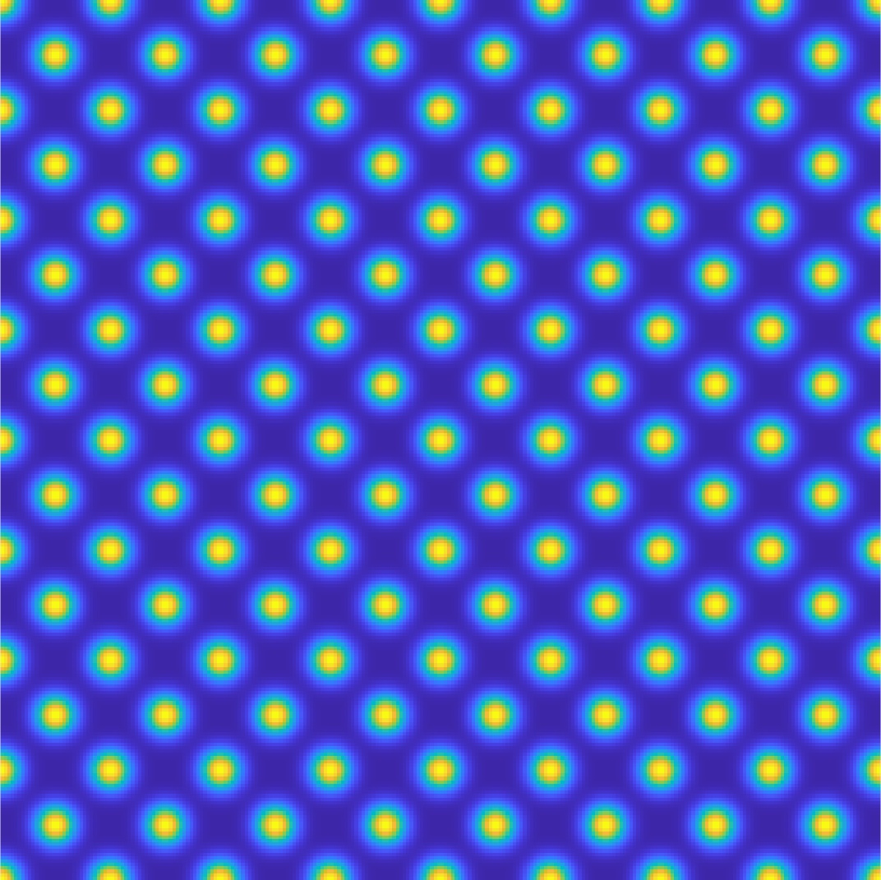
EDS potential: Delta or Gaussian?
Delta
Au [001]: 10 pm
Gaussian: 50 pm

Slide 10
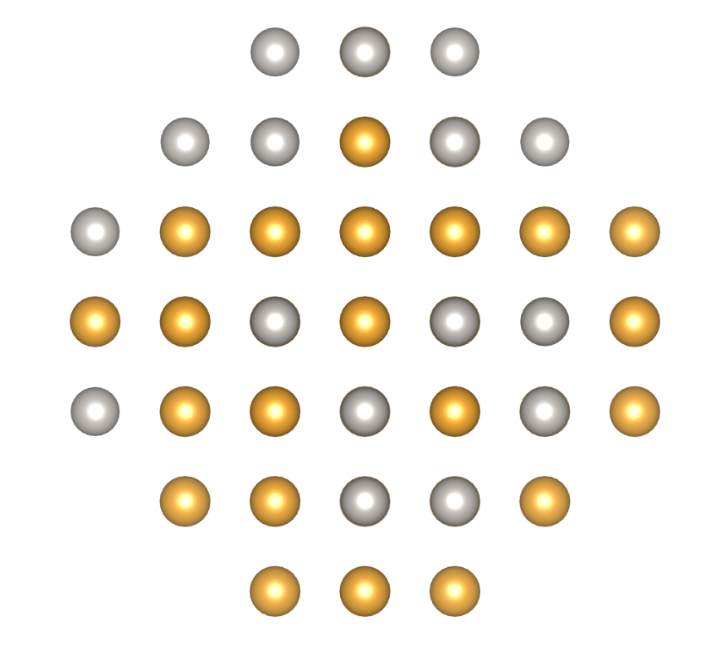
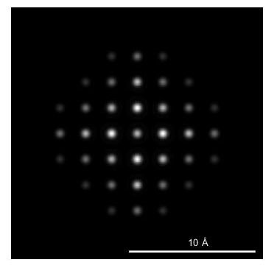
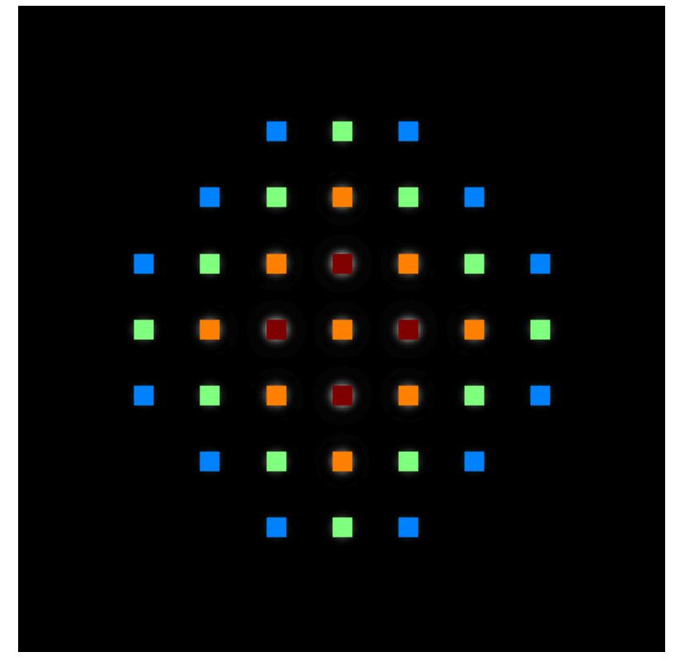
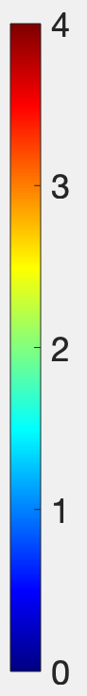
Example: Random ordering PtAu nano-octahedron
1. Compare full calculation with effective gaussian potential
2. Pt 30 Au 49 (ground truth)
3. 50-150 mrad
79 atoms in total

Slide 11
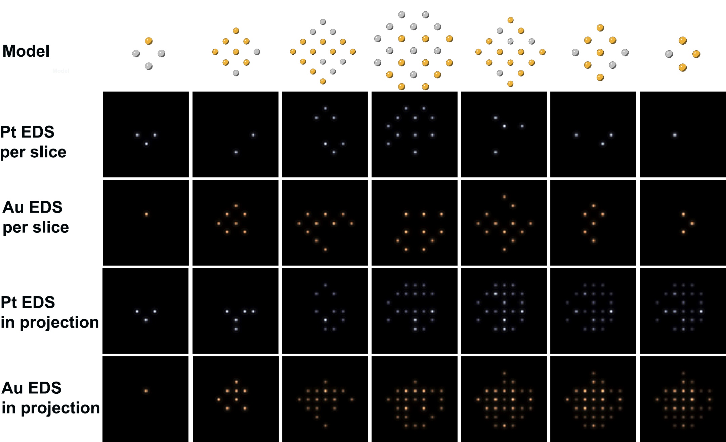
Example: Random ordering PtAu nano-octahedron

Slide 12
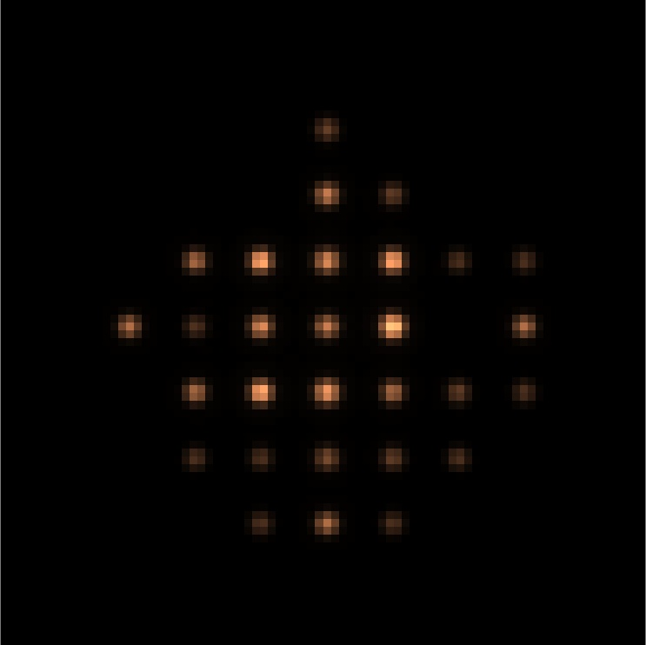
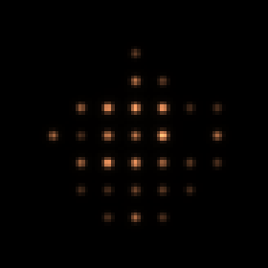
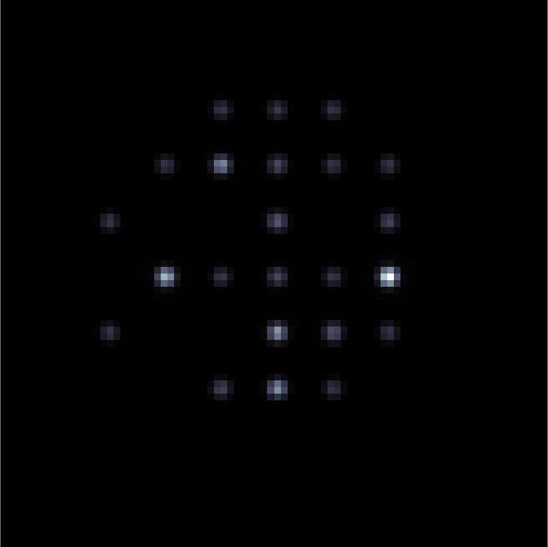
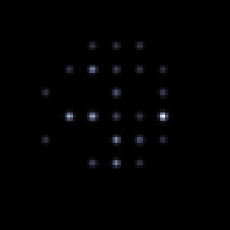
Example: Random ordering PtAu nano-octahedron
muSTEM inelastic potential
MULTEM Effective potential
Au
Pt

Slide 13
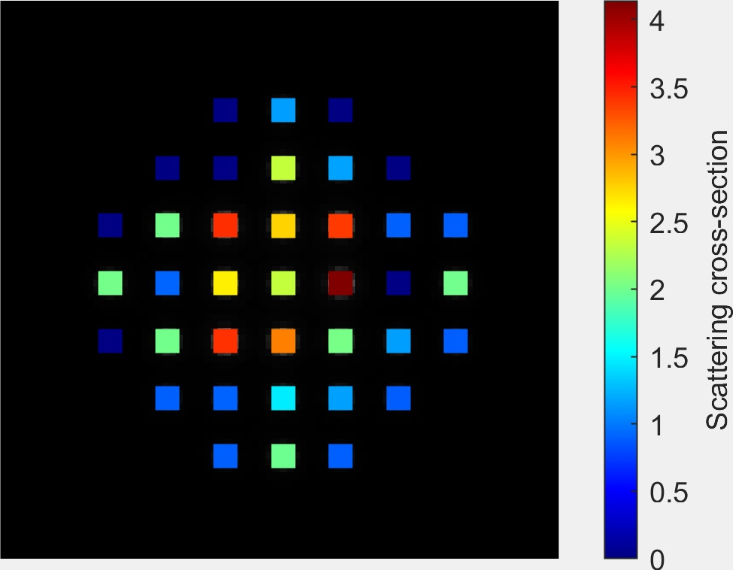
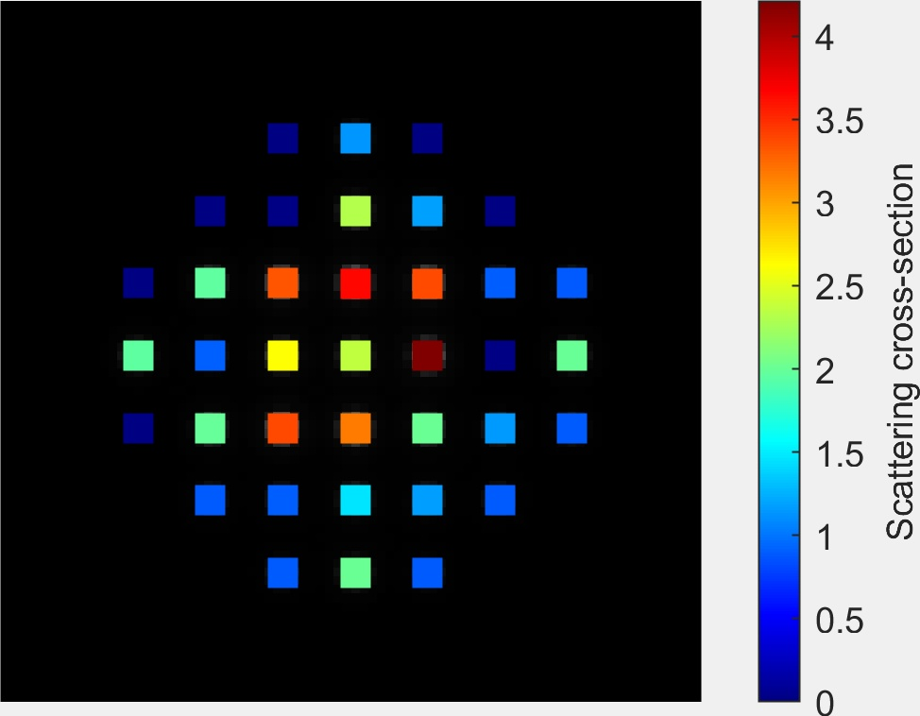
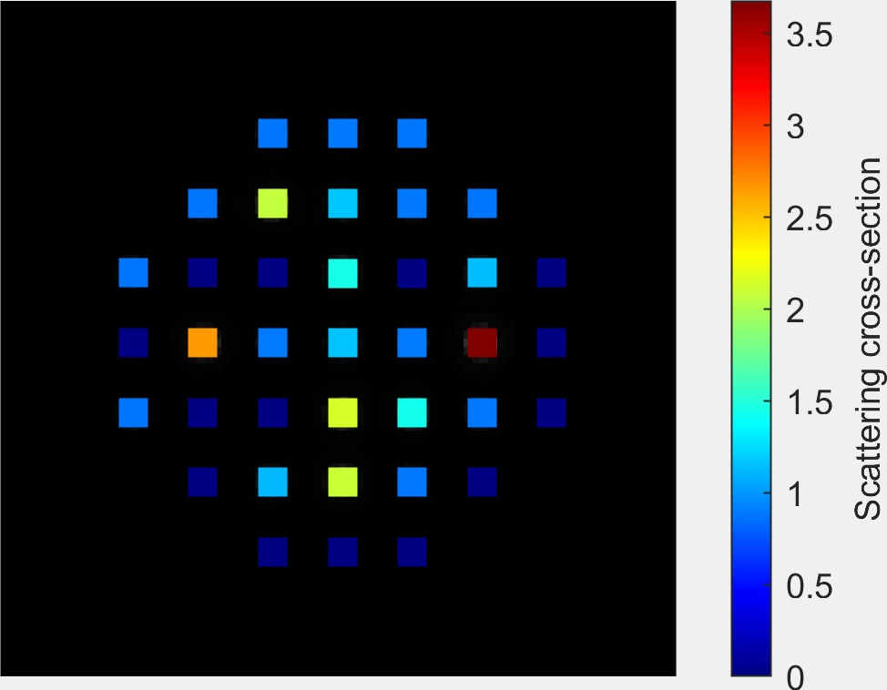
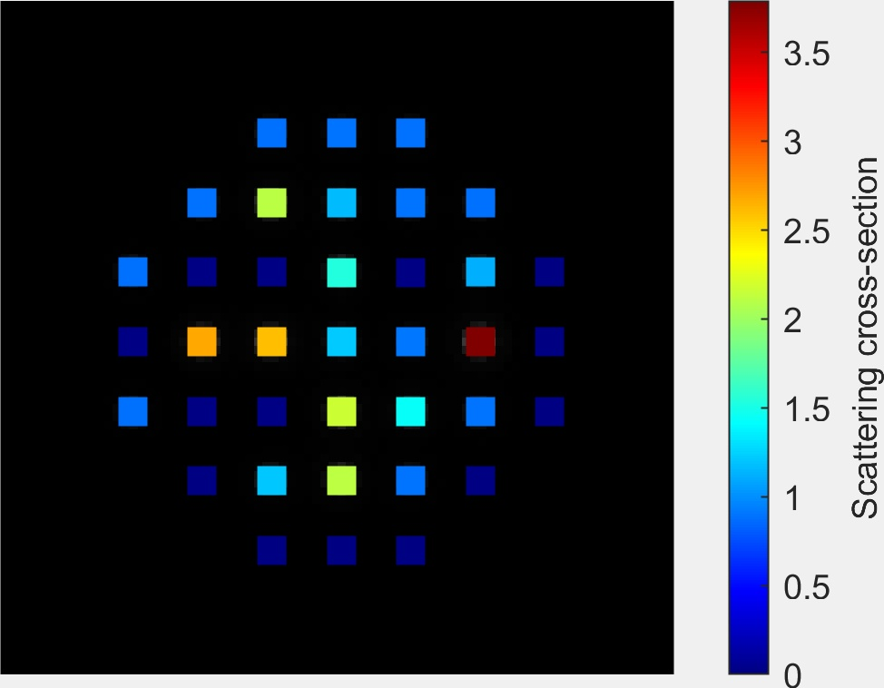
Example: Random ordering PtAu nano-octahedron
muSTEM inelastic potential
MULTEM Effective potential
Au
Pt
Normalised by the EDS scs of single atom in crystal
Both are frozen phonon calculations

Slide 14
Outline
EDX calculation using effective potential
ADF-EDS cross-section correlation
Atomic lensing model for spectroscopy

Slide 15

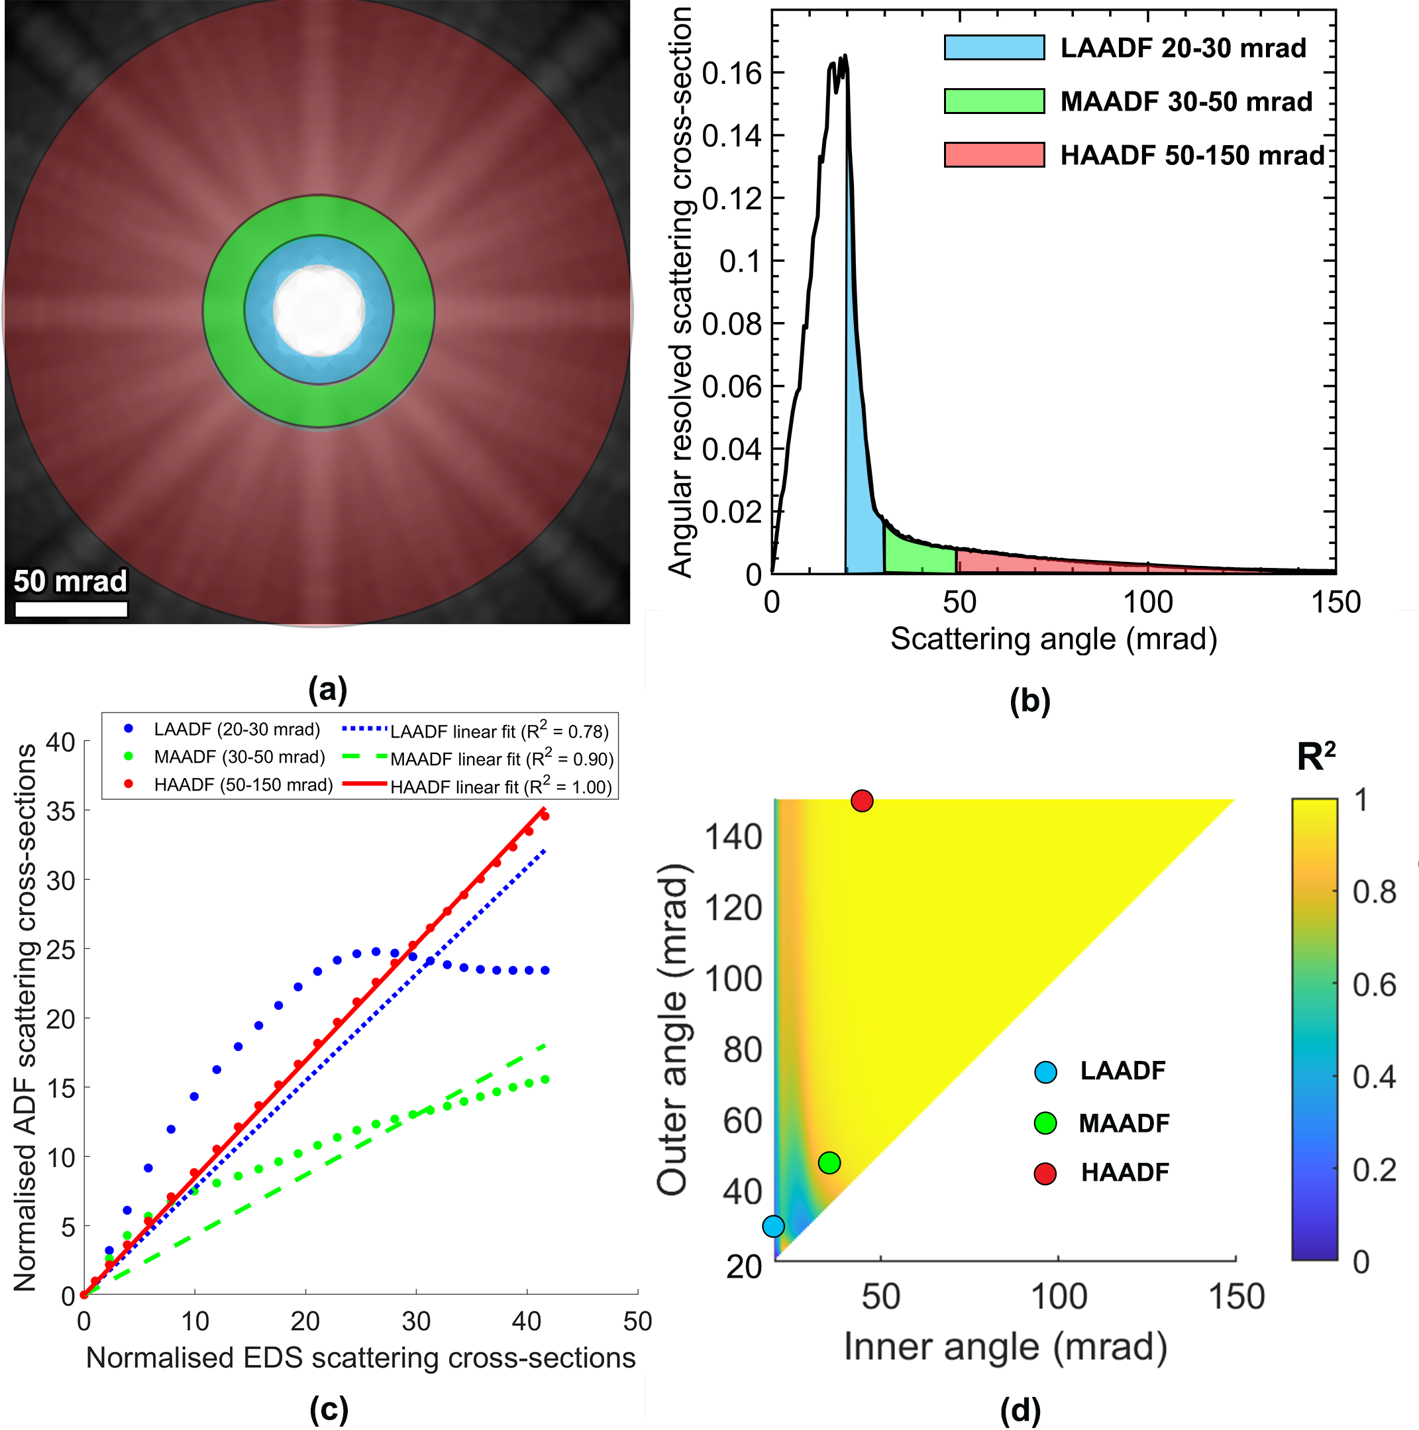
Angular-resolved annular dark field

Slide 16
Correlation between ADF-EDS cross-sections
Also a measure of coherency for ADF detector as a function of collection angles

Slide 17
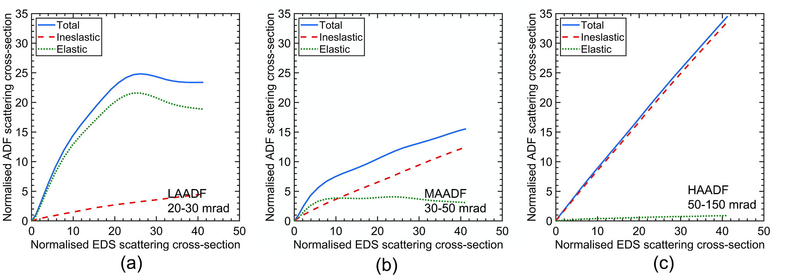
Elastic signals cause deviation from incoherent mode

Slide 18
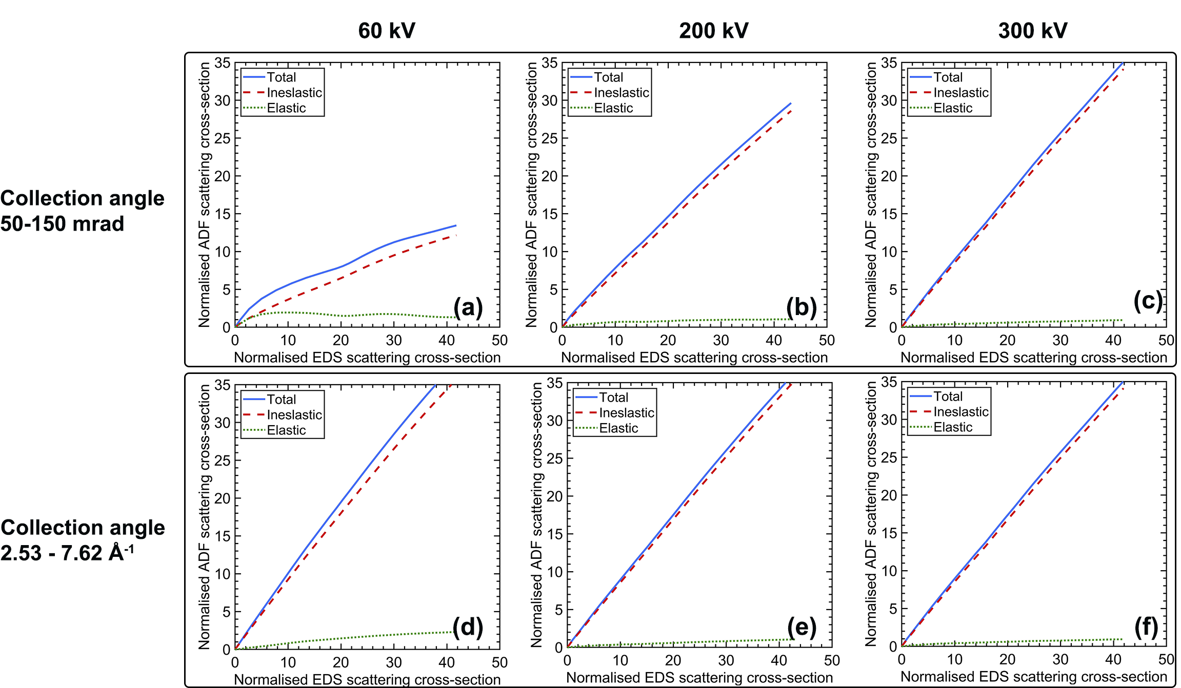
Keep incoherency,
keep the same scattering vector while varying voltage

Slide 19
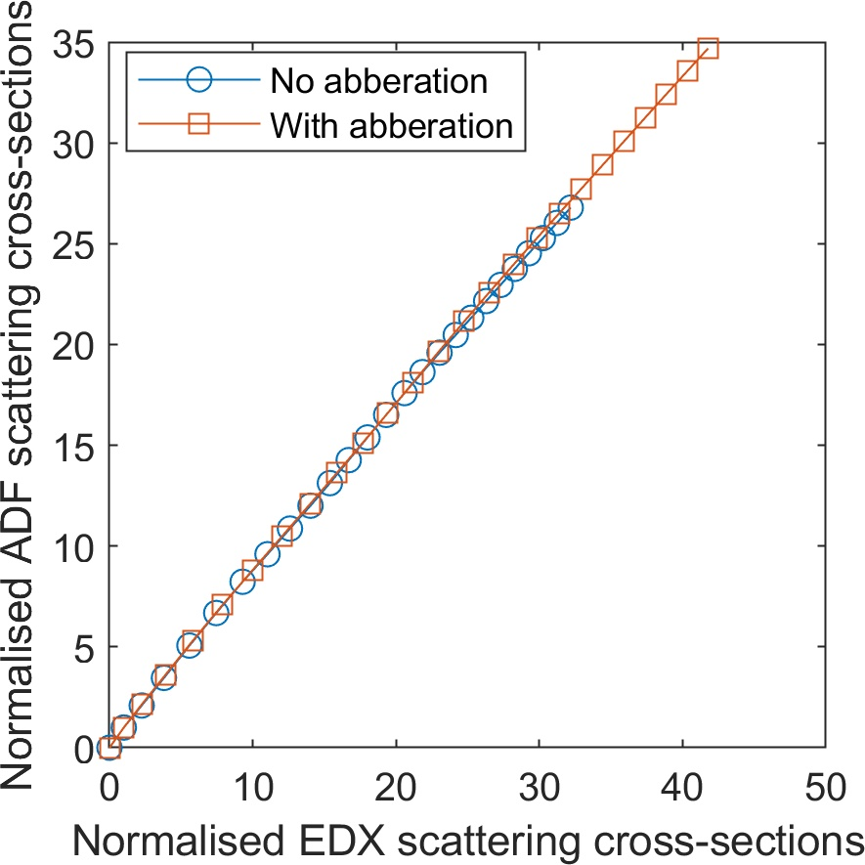
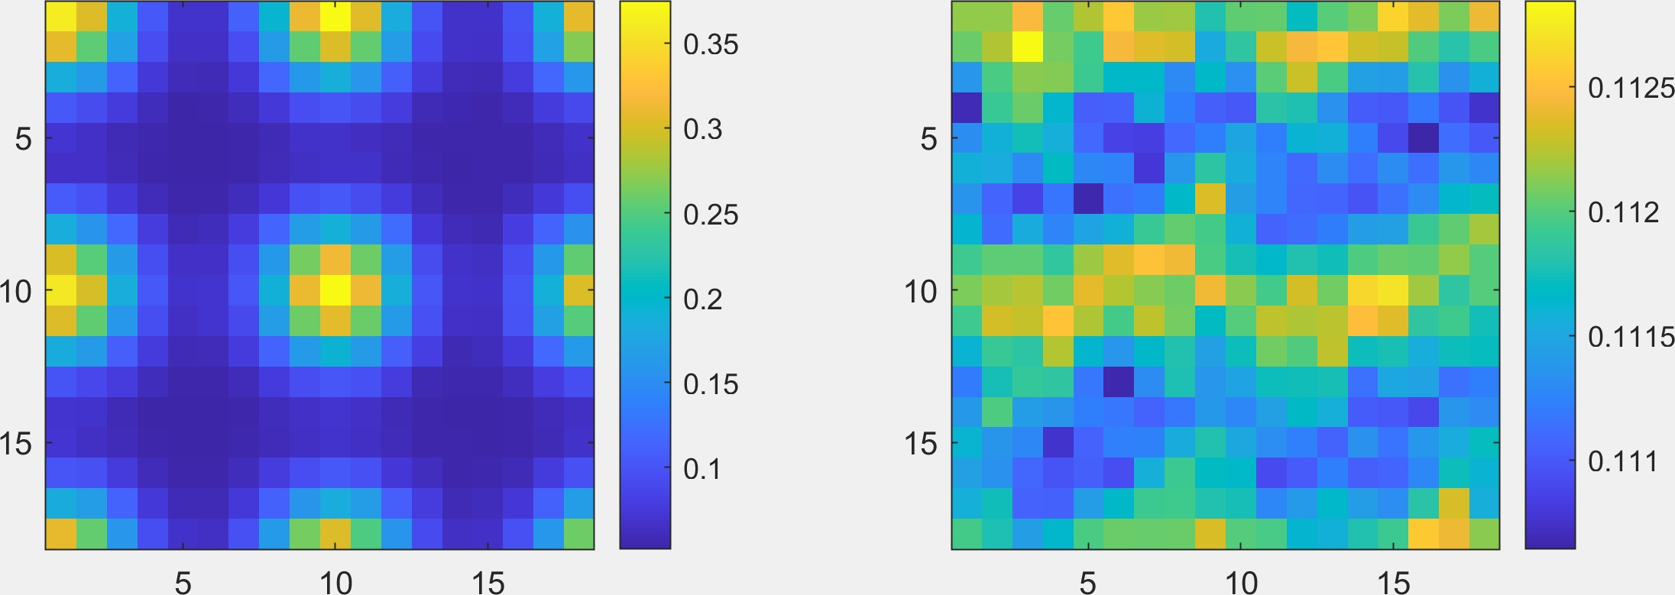
The correlation is robust against strong aberrations
No aberration
With aberration
Krivanek | Haider | Description | Size (Å) | Angle(rad)
C10 | C1 | Defocus | 100.0
C12 | A1 | 2-Fold astig. | 680.0 | -0.5200
C21 | B2 | Axial coma | 400.0 | -0.8300
C23 | A2 | 3-Fold astig. | 380.0 | 0.2500
C30 = CS | C3 | 3rd order spher. | 8700. | 0.000
C32 | S3 | Axial star aber. | 650.0 | -0.4880
C34 | A3 | 4-Fold astig. | 6400. | -0.8700

Slide 20
Outline
EDX calculation using effective potential
ADF-EDS cross-section correlation
Atomic lensing model for spectroscopy

Slide 21
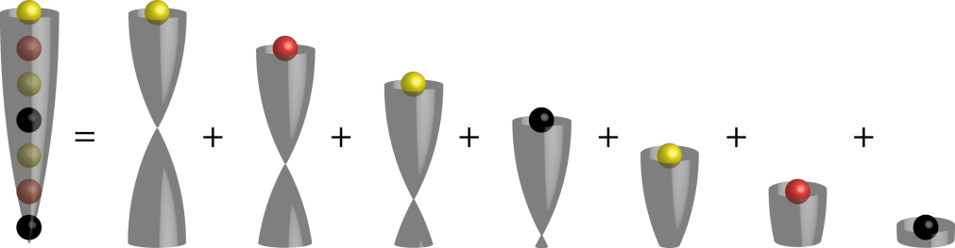
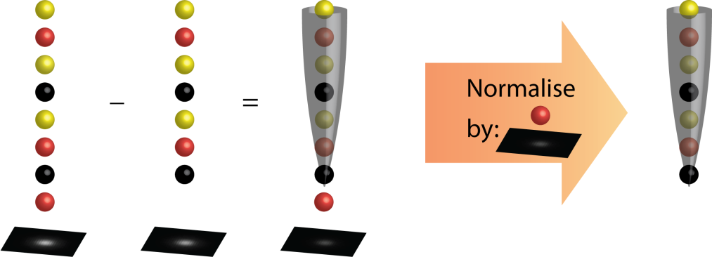
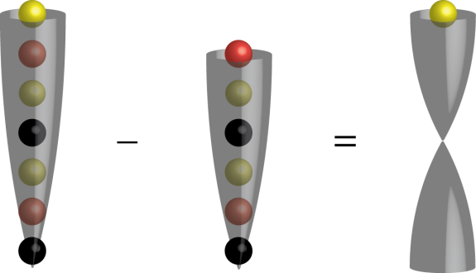
Atomic lensing model
Lensing effect is a superposition
Channelling theory
Lensing effect per atom – 1st derivative
Lensing effect per atom – 2nd derivative
K.H.W. van den Bos, S. Van Aert, IMC 2014, IT-2-P-2162.
K.H.W. van den Bos, P.D. Nellist, S. Van Aert, MC 2015, IM6.P152.

Slide 22

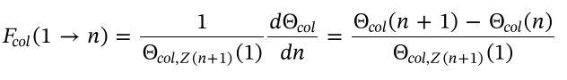
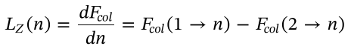
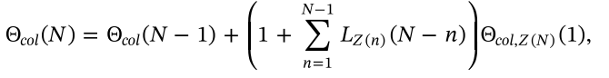
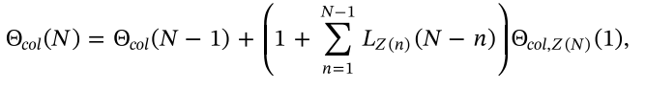
Atomic lensing model for spectroscopy
Focusing effect
Lensing effect
ALM ADF Prediction
Calculate lensing effect using ADF scs library times the scaling between ADF-EDS
include the
EDS/EELS scs of single atom.
Can be experimental scs or theoretical scs
ALM Spectroscopy Prediction
spec
spec
spec

Slide 23

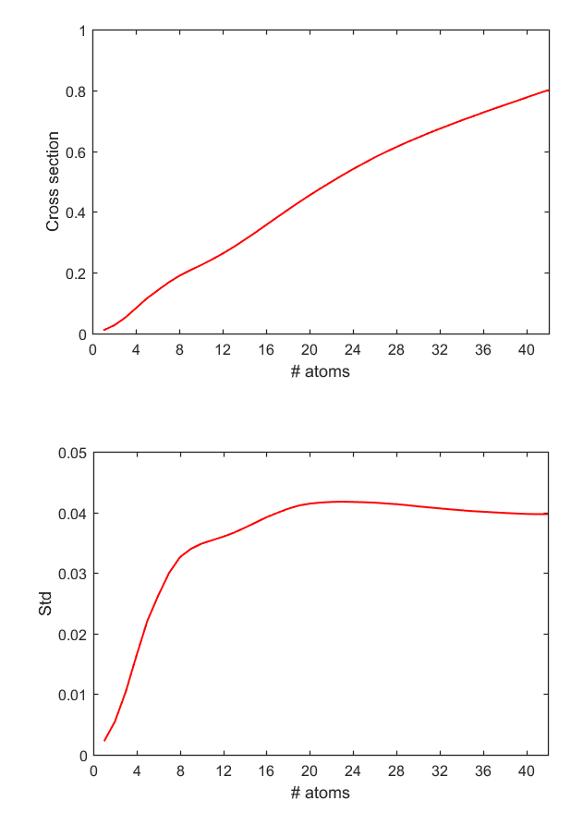
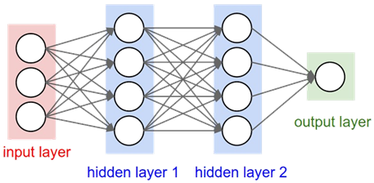
Generate library fast,
predict fast
ADF cross-section prediction using neural networks
Wide range of several parameters: aperture, collection angle, rms3d, aberrations
Before
~ 1.6 Hours
Now
~ 0.5 microseconds
Ivan Lobato
S. Van Aert
Presented in Atom 13

Slide 24
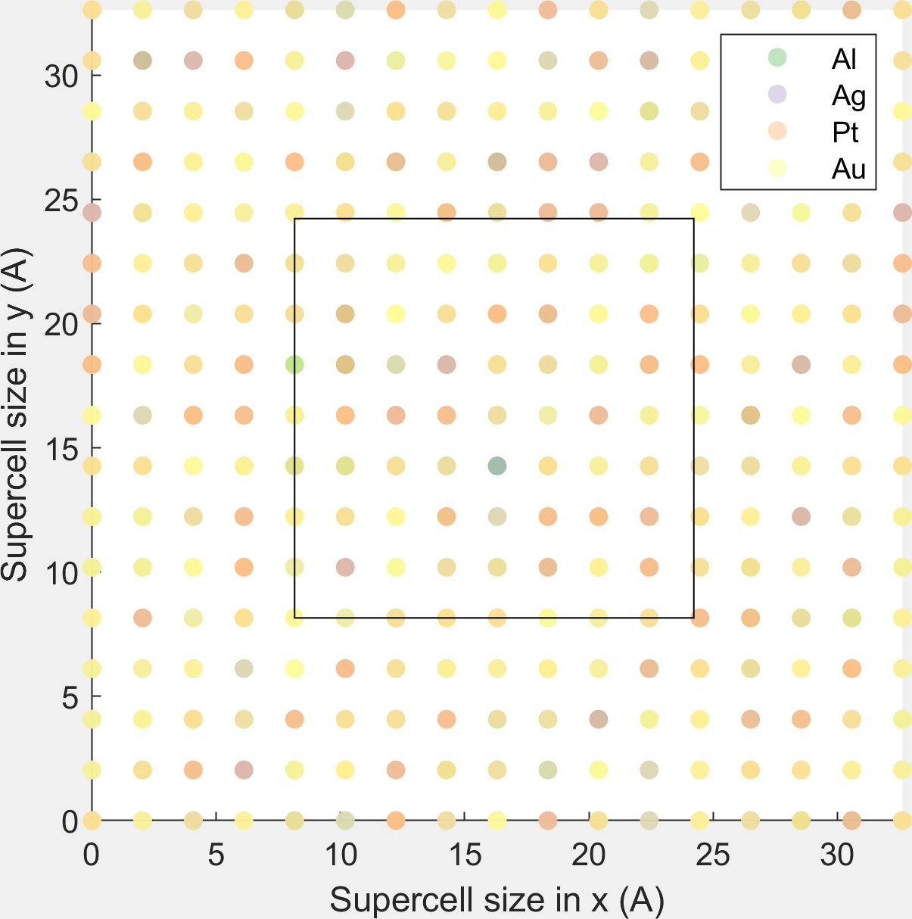

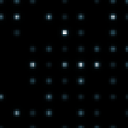
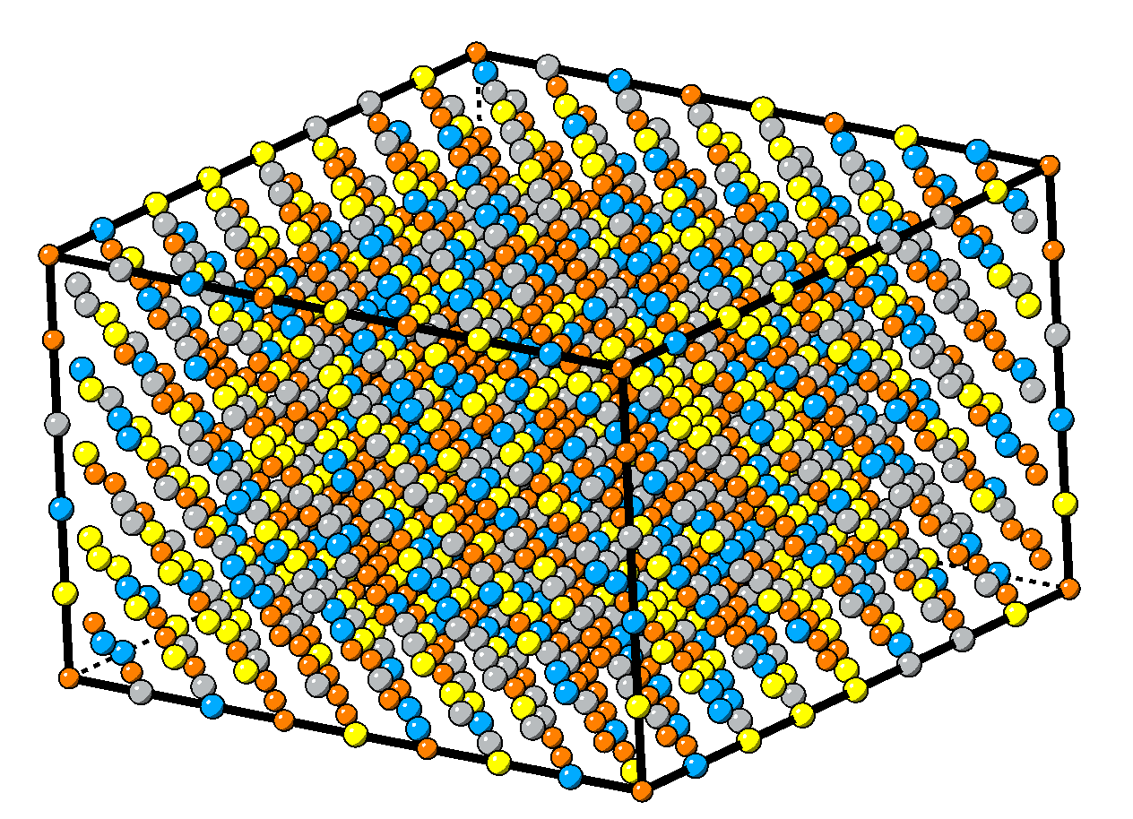
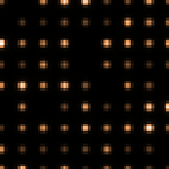
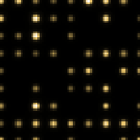
Example: high entropy alloy slab

Slide 25
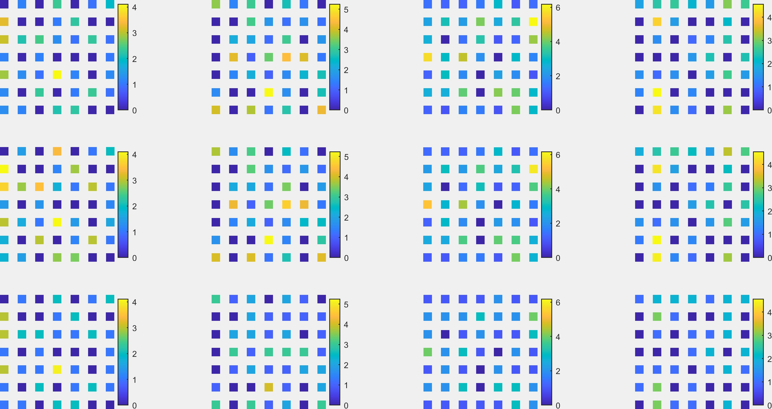
Example: high entropy alloy slab
Al
Ag
Pt
Au
Effective potential Simulation
ALM
Linear

Slide 26
Conclusion
Implemented partial cross-section with effective potential under electron channeling condition
Shape of potential: Delta, Gaussian
Linear dependence of HAADF-EDS cross-sections
Measure of ADF coherency
Extended atomic lensing model to spectroscopy
Predict fast using neural network generated library

